Slide 1

DEPARTMENT OF
ELECTRONIC AND TELECOMMUNICATION ENGINEERING
INTERNATIONAL ISLAMIC UNIVERSITY CHITTGONG (IIUC)
GROUP 22
A Deep CNN Biomedical Imaging Technique for Detecting Infected Covid Patients
Supervisor
Student
Engr. Razu Ahmed
Professor & Head
Department of Computer and Communication Engineering
International Islamic University Chittagong
Soumen Barua || T181056
Md. Sheikh Ejab || T181048

Slide 2
DEPARTMENT OF
ELECTRONIC AND TELECOMMUNICATION ENGINEERING
INTERNATIONAL ISLAMIC UNIVERSITY CHITTGONG (IIUC)
Supervisor's Recommandation

Slide 3
Table of Contents
I
Introduction
XII
Data Pre-Processing
II
Literature Review
XIII
Proposed Model
III
Motivation
XIV
Model Parameter
IV
Problem Statement
XV
Results
V
Social Effect
XVI
Comparisons
VI
Environmental Effect
XVII
Gantt Chart
XVIII
References
VII
Aims and Objective
VIII
Methodology of Research
IX
Platform and Tools
X
Implimentation
XI
Datasets

Slide 4
I
INTRODUCTION
Since it is a new viral strain, the name "coronavirus" is now prefixed with the word “Novel''.
The strain that started spreading in Wuhan, China's Hubei province capital, is a mix of two coronaviruses: severe acute respiratory syndrome (SARS) and Middle East respiratory disease (MERS). Indications of coronavirus infection include respiratory complications such as pneumonia, heart problems, and the formation of fluid in the lungs.
Along with laboratory testing, chest X-ray scans may be helpful to diagnose COVID-19 in individuals with a high clinical suspicion of infection.
The conventional diagnosis process has become relatively faster but still causes a high risk for medical staff.
Moreover, it is costly, and there exists a limited number of diagnostic test kits. On the other hand, medical imaging techniques (e.g., X-ray and CT) based screening are relatively safe, faster, and easily accessible. Compared to CT imaging, X-ray imaging has been extensively used for COVID-19 screening. It requires less imaging time and lower cost, and X-ray scanners are widely available even in rural areas.
Recently, studies have been conducted using Deep learning models related to the diagnosis of COVID-19 through X-ray images. Researchers discovered good accuracy as the clinical diagnostic test kit by applying a deep convolutional neural network with different Image-Net architecture and self-implemented algorithms.

Slide 5
II
LITERATURE REVIEW
Ref.
Year
Contribution and Research Direction
Area of the Main Focus
[1]
2017
Convolutional Neural Network (CNN) model for chest X-ray image classification The authors developed a small-sized CNN architecture due to pre-trained CNN models being known to present difficulties in practical applications.
Covid Detection
[2]
2017
A 12-class chest X-ray image dataset was used by the authors, with an 86% accuracy score reported in their testing.
Covid Detection
[3]
2017
A vast dataset containing chest X-ray images to which they applied deep CNN models for binary and multilevel classifications. Transfer learning with pre-trained Alex-Net, Res-Net, and VGG16 models was used with the constructed dataset
Covid Detection
[4]
2018
Developed an approach for abnormality detection using chest X-ray images. The authors proposed a hierarchical-CNN model named CXNet-m1 to overcome the over-fitting problem associated with transfer learning.
Covid Detection
[5]
2018
Detected pneumonia in chest X-ray images using five new deep-transfer-learning-based models applied as an ensemble. The authors reported a 96.4% accuracy score using their developed ensemble deep model.
Pneumonia Detection

Slide 6
II
LITERATURE REVIEW
Ref.
Year
Contribution and Research Direction
Area of the Main Focus
[6]
2018
Modified the AlexNet model for the detection of lung abnormalities based on chest X-ray images. A new “threshold filter” was introduced and a feature ensemble strategy was also defined which produced a 96% classification accuracy rate
Pneumonia Detection
[7]
2019
Segmentation based two deep CNN-based approaches were employed
Determine tuberculosis regions in lungs
[8]
2021
In this research, the present study analyzes the performance of 6 different deep network architectures as 2 Dense Convolutional Network Architectures (a DenseNet-121 and a DenseNet-161), 2 Residual Network Architectures (a ResNet-18 and a ResNet-34) as well as 2 VGG network architectures (a VGG-16 and a VGG-19, both with batch normalization)
Covid, Pneumonia, or Healthy detection
[9]
2018
Evaluate the sensitivity, specificity, and severity of chest radiographs and chest CT scans over time in patients confirmed positive for COVID-19 and those confirmed negative for COVID-19 and to evaluate determinants of false-negative results using logistic regression
Covid Detection

Slide 7
II
LITERATURE REVIEW
Ref.
Year
Contribution and Research Direction
Area of the Main Focus
[10]
2021
In this paper, researchers have proposed a method named COVIDLite, which is a combination of white balance followed by Contrast Limited Adaptive Histogram Equalization (CLAHE) and depth-wise separable convolutional neural network (DSCNN). In this method, white balance followed by CLAHE is used as an image preprocessing step for enhancing the visibility of CXR images and DSCNN trained using sparse cross-entropy is used for image classification with lesser parameters and significantly lighter in size
Covid Detection
[11]
2021
IThis paper demonstrates the efficacy of a novel, highly accurate, and proficient COVID-DeepNet model with CNN for detecting COVID-19 and non-COVID Pneumonia for acutely symptomatic patients. The proposed deep learning model distinguishes an X-ray image into COVID-19, non-COVID Pneumonia, and normal at an efficient rate.
Covid Detection
[12]
2022
A detailed survey of the available deep learning approaches for the detection of coronavirus infection from images such as CT scans or CXR images is conducted in this paper
Covid Detection

Slide 8
III
MOTIVATION
The global crisis brought on by COVID-19 has affected us all. Like many businesses, we are struggling to make the most of our current crisis services.
During this pandemic, we tried to sort out the problem using artificial intelligence.
We came up with an idea and researched with my thesis mate to develop a convolutional neural network for COVID-19 detection via chest x-ray. We’ve used COVID CXR Image Dataset (Research) from Kaggle, an open-access benchmark dataset comprising 1823 CXR images across many patient cases.
The model is cost-effective and can aid the radiologists to verify their decisions.
The major purpose of this research is to take faster decisions for quarantine of patients that can ultimately help in reducing the spread of COVID-19 infection.

Slide 9
IV
PROBLEM STATEMENT
The conventional diagnosis process has become relatively faster but still causes a high risk for medical staff.
It is costly and there exists a limited number of diagnostic test kits.
Medical imaging techniques are safe, faster, and easily accessible.
X-ray imaging has been extensively used for COVID-19
Requires less imaging time, and lower cost, and X-ray scanners are widely available even in rural areas.

Slide 10
V
SOCIAL EFFECT
Neural networks are changing how people and organizations interact with systems, solve problems, and make better decisions and predictions.
The new approach will play a vital role in the social effect.
People can easily detect the Covid-19 by taking their Chest X-rays.
Additionally, the waiting time was reduced compared to a blood test.

Slide 11
VI
ENVIRONMENTAL EFFECT
There is no bad effect on the environment.
It can be a powerful tool to combat climate change, but its role also as a contributor to emissions cannot be overlooked.
The first step to making it greener is to promote the practice of more holistic and multidimensional model evaluation.
By changing our mindset that bigger is always better and by pursuing AI use cases in the environmental space,

Slide 12
VII
AIMS AND OBJECTIVE
To design a Deep CNN model based on detecting infected covid chest Xrays.
We will preprocess our image white balance and CLAHE to improve image quality and remove noises.
We will try to improve our accuracy at the benchmark level.
After improving our accuracy our focus will be to fit the model perfectly.
Next, we have to calculate the confusion matrix to know how accurately the model works.
Also focus will be the calculating its performance like f-1 score, recall, precision, sensitivity, etc.

Slide 13
VIII
METHODOLOGY OF RESEARCH
Understanding
the topic
Select the topic
Literature Review
Problem statement
Binary Classification
Dataset Colection
Preprocessing the images
METHODOLODY OF
RESEARCH
Train Dataset
Data split
Test Dataset
Validation Dataset
Train and validate dataset
Model Bulid
(CNN)
Compile the model
High Accuracy with Performance

Slide 14

IX
IMPLIMENTATION
Phase 1
Dataset collection
Covid Chest Xray dataset (Covid IEEE) Collected From Kaggle – A open-source dataset platform.
Phase 2
Data Preprocessing
This Step we use Scaling, Image processing (CLAHE+WB) & Data augmentation technique
Phase 3
Proposed Model
The deep convolution neural network using hidden Layer & 5M trainable parameter Used.
Phase 4
Model Parameter
The model is Fitted by 300 epochs and batch size is 16 & input target shape is 224 x 224 x 3.

Slide 15
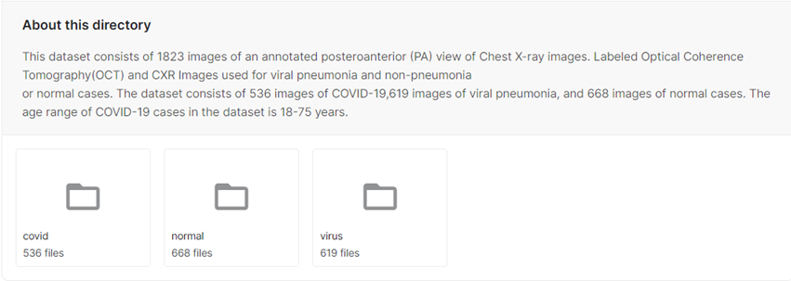
X
DATASET COLLECTION
COVID CXR Image Dataset (Research)
About Dataset
The whole world is suffering from COVID-19 disease and its proper and timely diagnosis is the need of the hour. So for building an efficient AI-based diagnostic system we have collected Chest ray images from different sources so that we can train our CNN model for automating the whole diagnosis method. Therefore we have collected Chest ray images from different sources and research papers and combined them to create one comprehensive dataset that can be used by research community.
Content
This dataset consists of a posteroanterior (PA) view of chest X-ray images comprising Normal, Viral, and CVOID-19 affected patients. There are total 1823 CXR images.

Slide 16
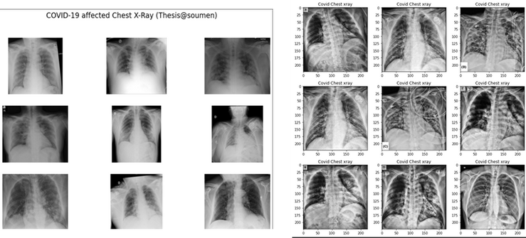
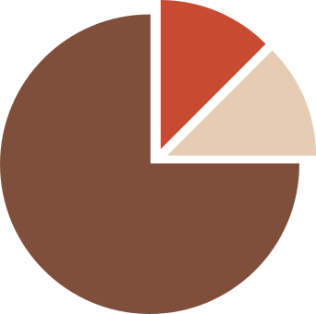
XI
DATASET PRE-PROCESSING
Step 1. Image Processing
White Balance: Try to correct for the ambient light with minimum input from the user, so that the resulting image looks like what our eyes would see.
Contrast Limited AHE (CLAHE): CLAHE is a variant of adaptive histogram equalization in which the contrast amplification is limited, so as to reduce this problem of noise amplification.
Scaling: Scaled the images into 224 x 224 pixels.
(a)
(b)
Figure: (a) without image processing (b) with image processing
Step 2. Image Split & Augmentation
Split: The Datasets are divided into 3 categories, train, test, and validation.
Image Augmentation: A technique of altering the existing data to create some more data for the model training process by rotating images at 45 degrees, shearing, zooming, etc.
20%
Train Dataset
Test Dataset
Validation Dataset
20%
60%

Slide 17
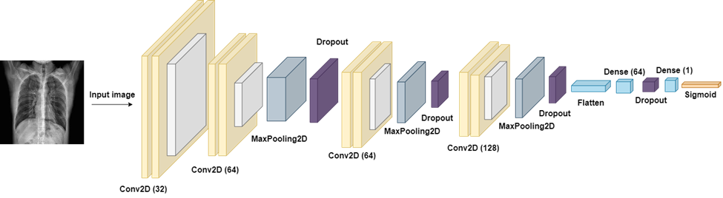
XII
PROPOSED MODEL
Convolutional Neural Network (CNN)
It is a Deep Learning algorithm
Can take in an input image, assign importance (learnable weights and biases) to various aspects/objects in the image and be able to differentiate one from the other.
COVID
NORMAL
Figure: Proposed CNN Model layer

Slide 18
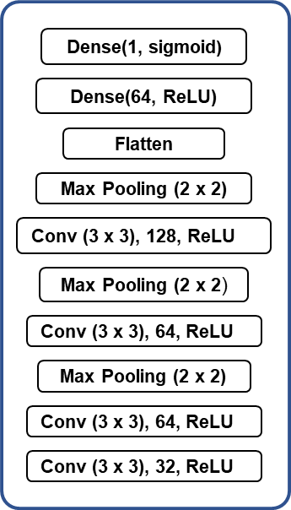
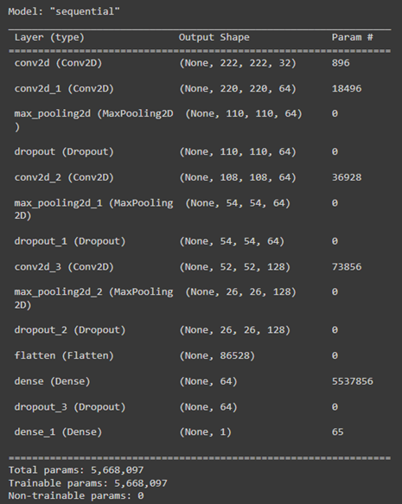
XII
PROPOSED MODEL
Other Parameter
Batch Size = 16
Activation Function = ReLU
Dropout=20%
Output Activation Function = Sigmoid
Epochs=300
(a)
(b)
Figure: (a) Proposed model layers (b) Model summary

Slide 19
XII
PROPOSED MODEL
Optimizer:
Loss function for binary classification:
The optimizer is used to decrease the rates of error during training the neural networks.
In our model we used Adam as an optimizer.
Adam optimizers id defined as a process used as a replacement optimizer for gradient descent. It is very efficient with large problems which include lots of data.
Binary cross entropy compares each of the predicted probabilities to the actual class output which can be either 0 or 1.
•It then calculates the score that penalizes the probabilities based on the distance from the expected value which means how close or far from the actual value.
•Binary Cross Entropy is the negative average of the log of corrected predicted probabilities.
17
2

Slide 20
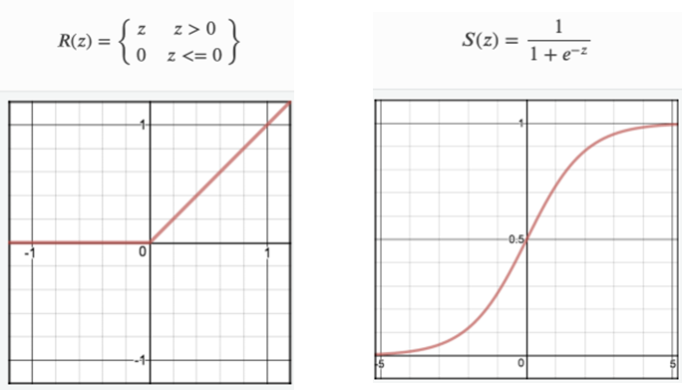
XII
PROPOSED MODEL
Hidden layer activation function: ReLU (Rectified Linear Unit)
This is most popular activation function which is used in hidden layer of NN.
The formula is deceptively simple: 𝑚𝑎𝑥(0,𝑧) max(0,z).
Output layer activation function: Sigmoid
Sigmoid Activation function is very simple which takes a real value as input and gives a probability that‘s always between 0 and 1.
(a)
(b)
Figure: (a) ReLU (b) Sigmoid

Slide 21
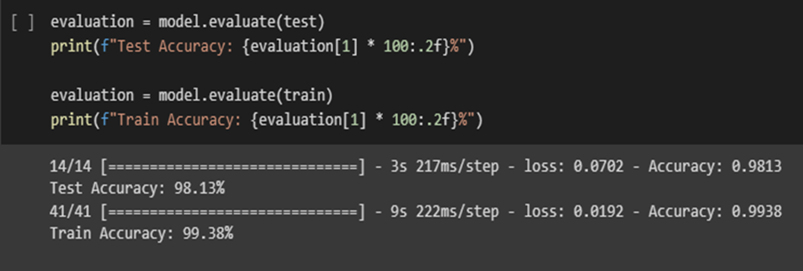
XIV
RESULTS & DISCUSSION
The proposed model is showing satisfactory results in the figure with 99.38% Training accuracy with actual accuracy is 98.13% which is Test accuracy.
It means our model can predict 98 images accurately out of 100 images.
Figure: Accuracy

Slide 22
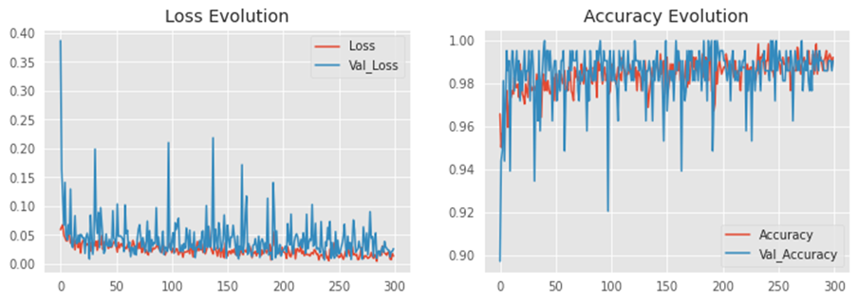
XIV
RESULTS & DISCUSSION
Our model is well fit after running 300 epochs which is represented in 2 graphs below in figure including Train accuracy & validation accuracy and also train loss and validation loss.
Figure: Loss and accuracy graph

Slide 23
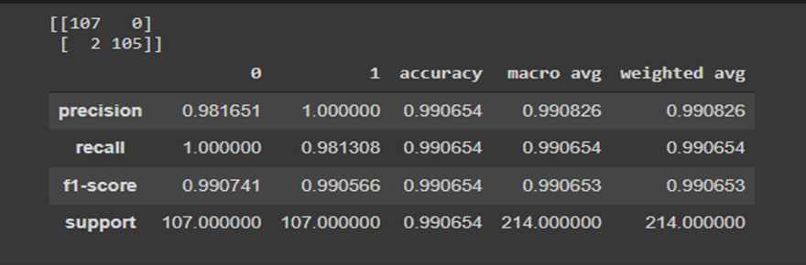
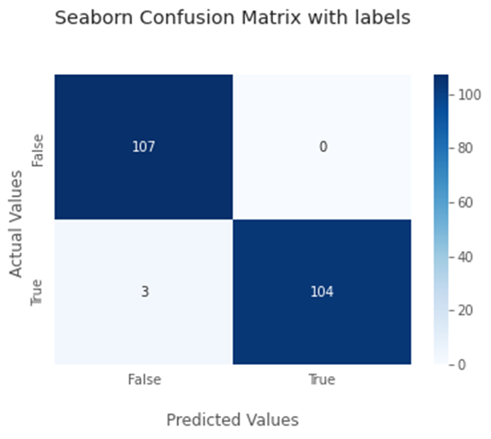
XV
RESULTS & DISCUSSION
Model Performance (0= Covid, 1= Normal)
Figure: Fig: Model performance data
Confusion Matrix
A confusion matrix is a tabular summary of the number of correct and incorrect predictions made by a classifier.
It is used to measure the performance of a classification model.
Proposed models confusion matrix is shown in figure z.
Figure: Confusion matrix

Slide 24
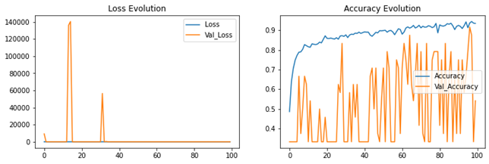
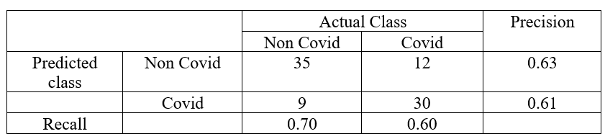
XV
RESULTS & DISCUSSION
VGG16 model graph & Perdormance
Figure: Accuracy and loss graph vs epochs
Table The performance of VGG16

Slide 25
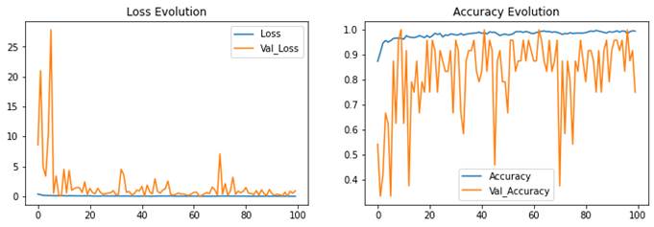
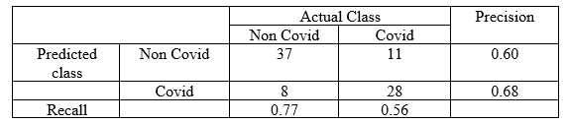
XV
RESULTS & DISCUSSION
Densenet model graph and performance
Figure: Accuracy and loss graph vs epochs
Table: The performance of Densemet

Slide 26
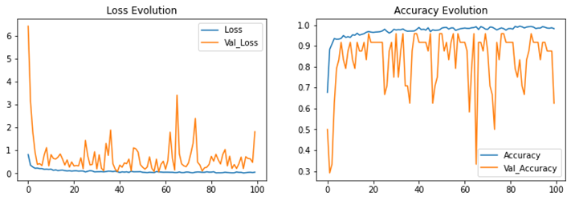
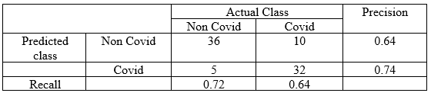
XV
RESULTS & DISCUSSION
InceptionV3 model graph and performance
Figure: Accuracy and loss graph vs epochs
Table: The performance of Inception v3

Slide 27
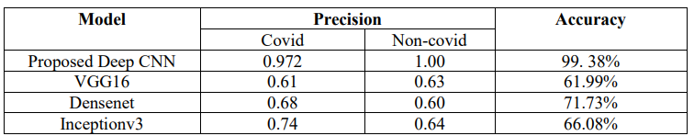
XV
COMPARISONS
Comparison of our model with Transfer learning model
Table: Comparing our proposed model with simulated transfer learning approaches

Slide 28
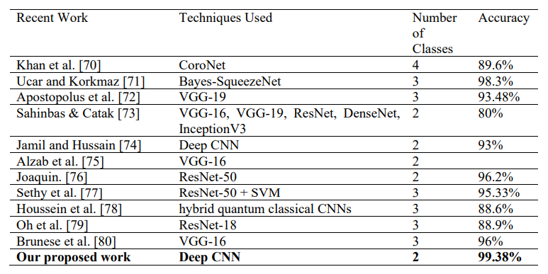
XV
COMPARISONS
Comparison of our model with Transfer learning model
Table: Comparison of our work with recent works

Slide 29

XVI
GANTT CHART
TASK
WEEK 1-4
WEEK 5-10
WEEK 11-15
WEEK 16-18
Problem Selection
Background study
Literature Review
Deciding the Problem Statement
Identifying Research Objectives
Designing the Research
Model Impliment
Optimization Process
Result collection
Writting the paper

Slide 30
XVII
REFERENCES
[1] Y. Dong, Y. Pan, J. Zhang and W. Xu, "Learning to Read Chest X-Ray Images from 16000+ Examples Using CNN," 2017 IEEE/ACM International Conference on Connected Health: Applications, Systems and Engineering Technologies (CHASE), 2017, pp. 51-57, doi: 10.1109/CHASE.2017.59.
[2] Liu, Chang, Yu Cao, Marlon Alcantara, Benyuan Liu, Maria Brunette, Jesus Peinado, and Walter Curioso. "TX-CNN: Detecting tuberculosis in chest X-ray images using convolutional neural network." In 2017 IEEE international conference on image processing (ICIP), pp. 2314-2318. IEEE, 2017.
[3] Y. Dong, Y. Pan, J. Zhang, and W. Xu, "Learning to Read Chest X-Ray Images from 16000+ Examples Using CNN," 2017 IEEE/ACM International Conference on Connected Health: Applications, Systems and Engineering Technologies (CHASE), 2017, pp. 51-57, doi: 10.1109/CHASE.2017.59.
[4] Xu, Shuaijing, Hao Wu, and RongfangBie. "CXNet-m1: Anomaly detection on chest X-rays with image-based deep learning." IEEE Access 7 (2018): 4466-4477.
[5] Chouhan, Vikash, Sanjay Kumar Singh, Aditya Khamparia, Deepak Gupta, Prayag Tiwari, Catarina Moreira, Robertas Damaševičius, and Victor Hugo C. De Albuquerque. "A novel transfer learning-based approach for pneumonia detection in chest X-ray images." Applied Sciences 10, no. 2 (2020): 559.
[6] Rajpurkar, Pranav, Jeremy Irvin, Robyn L. Ball, Kaylie Zhu, Brandon Yang, Hershel Mehta, Tony Duan et al. "Deep learning for chest radiograph diagnosis: A retrospective comparison of the CheXNeXt algorithm to practicing radiologists." PLoS medicine 15, no. 11 (2018): e1002686.
[7] Souza, Johnatan Carvalho, João Otávio Bandeira Diniz, Jonnison Lima Ferreira, Giovanni Lucca França da Silva, Aristofanes Correa Silva, and Anselmo Cardoso de Paiva. "An automatic method for lung segmentation and reconstruction in chest X-ray using deep neural networks." Computer methods and programs in biomedicine 177 (2019): 285-296.
[8] de Moura, Joaquim, Jorge Novo, and Marcos Ortega. "Fully automatic deep convolutional approaches for the analysis of COVID-19 using chest X-ray images." Applied Soft Computing 115 (2022): 108190.
[9] Stephanie, Stephanie, Thomas Shum, Heather Cleveland, Suryanarayana R. Challa, Allison Herring, Francine L. Jacobson, Hiroto Hatabu et al. "Determinants of Chest Radiography Sensitivity for COVID-19: A Multi-Institutional Study in the United States." Radiology: Cardiothoracic Imaging 2, no. 5 (2020): e200337.
[10]Siddhartha, Manu, and Avik Santra. "COVIDLite: A depth-wise separable deep neural network with white balance and CLAHE for detection of COVID-19." arXiv preprint arXiv:2006.13873 (2020).
[11] Panthakkan, Alavikunhu, S. M. Anzar, Saeed Al Mansoori, and Hussain Al Ahmad. "A novel DeepNet model for the efficient detection of COVID-19 for symptomatic patients." Biomedical Signal Processing and Control 68 (2021): 102812.
[12] Subramanian, Nandhini, Omar Elharrouss, Somaya Al-Maadeed, and Muhammed Chowdhury. "A review of deep learning-based detection methods for COVID-19." Computers in Biology and Medicine (2022): 105233.

Slide 31
Thank You
Any Questions?

